Slide 1
To-do tracker
Capstone project

Slide 2

Content
Team Members
Objective
Introduction of Project
Tools and Technologies Used
Architecture diagram
Functionality
Demo
Future Enhancement

Slide 3

Team Members
Meenakshi Tayade
Shivani Jaju

Slide 4
Objective
The purpose of the to-do list tracker is to help users to prioritize their task and complete it on time. to-do list tracker app with multiple list options allows you to store all of these to-dos in one place. Set start dates, due dates, task status and priorities.
Your to-dos, whether for a “me” day or critical project deadlines, don't mean much if they're not done in time.

Slide 5
Introduction
Introducing the To-Do List Tracker Application, your essential tool for mastering organization and productivity. Designed for anyone looking to streamline their tasks and achieve their goals, our app offers a simple yet powerful solution.
Say goodbye to the hassle of juggling multiple to-do lists and hello to a more efficient way of managing your day. With user-friendly features, staying on top of your priorities has never been easier. Whether you're tackling school assignments, personal projects, or anything in between, our To-Do List Tracker has you covered.

Slide 6
Tools & Technology
HTML
CSS
TypeScript
Angular
Material UI
Frontend
Spring Boot
Spring Cloud
Backend
MySql
MongoDB
Database

Slide 7

Architecture Diagram
Login
MySQL
Token
User
Authentication Service
A
P
I
Gateway
E
U
R
E
K
A
Server
save user
Feign Client
Client
Register user
User
Task Service
Mongo
Database
register

Slide 8
Functionality
This application offers signup and login features for authentication, allowing access to the To-Do tracker services.
All authorized users have the ability to update properties of their tasks. This includes details such as task descriptions, due dates, priorities.
Users can create new tasks or to-dos, often including details such as due dates, priorities, descriptions.
Users can prioritize tasks based on urgency or importance, ensuring that important tasks are completed on time.
Users can track the progress of their tasks, mark them as completed, and the task can be put in the archive list.

Slide 9
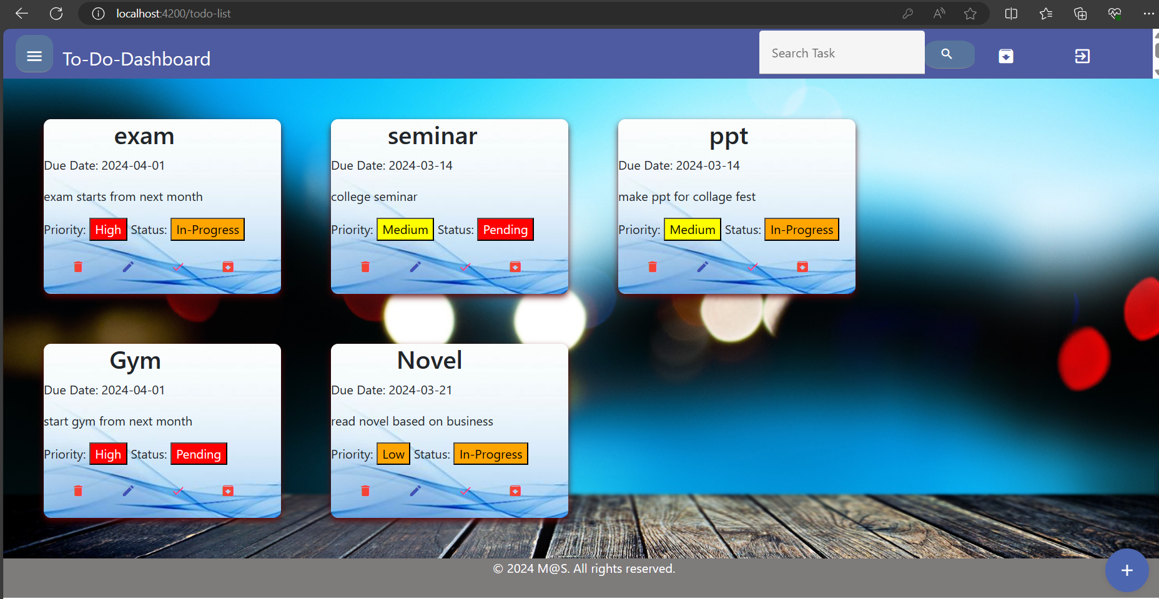
Demo – todo-list page

Slide 10
Future Enhancement
Collaborative To-Do Lists: Enable users to share and collaborate on to-do lists with other users, allowing for teamwork and task delegation.
Attachments and Comments: Allow users to attach files or add comments to their tasks for additional context or information.
Integration with Calendar and Email: Integrate the application with popular calendar and email platforms to sync tasks and events seamlessly across multiple devices and platforms.
Data Backup and Restore: Implement data backup and restore functionality to prevent data loss and allow users to recover their to-do lists in case of accidental deletion or device failure.

Slide 11
Thank You

